Slide 1
NEGOTIATING ACROSS CULTURES

Slide 2
CONTENTS
Introduction
Principles of negotiation
Pre negotiations
Post negotiations
Intercultural communication and the negotiation process
Negotiation framework
The influence of organizational culture and individual personality
Culture and emotions in intercultural negotiations
Negotiation styles in different countries
Culturally responsive negotiation strategies

Slide 3
INTRODUCTION
Negotiations are an integral part of a managers life.
Managers are always trying to secure agreements with their supervisors and subordinates.
The traditional image of a negotiation is often of ‘bargaining table’.
International business negotiations are multifaceted and go beyond just the price.

Slide 4
PRINCIPLES OF NEGOTIATION
All negotiations have the following four key elements:
Multiple parties
Multiple motives
Movement of the parties
A goal of reaching a agreement
Negotiations are broadly classified as:
Distributive negotiation
Integrative negotiation
Negotiators must also be aware of the best alternative to a negotiated agreement (BATNA)

Slide 5
PRE- NEGOTIATIONS
In the pre- negotiations stage, parties attempt to understand each other’s needs and demands.
During pre- negotiations, each party:
Identifies the contents of the deal and its implications
Creates alternatives so that there are overlaps between the positions of both parties
Understands the other party’s position
Builds power by strengthening its best alternative to a negotiated agreement (BATNA) and gauging the other party’s BATNA

Slide 6
POST- NEGOTIATIONS
In the posy- negotiations stage, the parties involved have agreed to most of the issues.
The parties agree on the format of the contract and signing of the contract.
The main purpose of the contract is to avoid misunderstandings and future problems, and to foster the development and maintenance of a relationship.
Communication is an integral part of the negotiation process.

Slide 7
INTERCULTURAL COMMUNICATION AND NEGOTIATION PROCESS
Communication style plays a major role in the negotiation process. Some of the important communication variables influencing negotiations are:
Language
Interpreters, translators and mediators
Shared experiences
Humour
Listening skills
Pace
Time
Socialization
Business etiquette
Agenda

Slide 8
Negotiation Framework
Given by Weiss & Stripp (1985) has been simplified by Moran & Stripp (2004).
Twelve Variables included in this framework are:
Basic concept of Negotiation
Selection of Negotiators
Role of individual aspiration
Concern with protocol
Significance of type of issue
Complexity of language
Nature of persuasive argument
Value of time
Bases of trust
Risk-taking propensity
Internal decision-making systems
Form of satisfactory agreement

Slide 9
Basic Concept of Negotiation:
Distributive- competition & confrontation. Integrative - cooperative & trusting.
Negotiators from feminine cultures will tend to be less aggressive & those from masculine culture may be more aggressive.
Selection of Negotiators:
Negotiators can be selected on the basis of their technical skills, seniority, experience in the field, & interpersonal skills.
Role of individual aspirations:
In individualistic cultures, negotiators may choose to fulfil private goals where as in collectivist culture like Japan, group interests are fulfilled rather than that of organisation.

Slide 10
Concern with Protocol:
Negotiators from some cultures are formal & expect good manners &
conduct. Importance is given to formal introductions, presentation of business cards, exchange of gifts etc.
Significance of type of issue:
Issues can be: substantive or task-related and relationship-based. Substantive issues deal with the use of resources such as space, money,
property, power and prestige whereas Relationship-based issues deal with the
maintaining of an on-going relationship.
Complexity of Language:
Negotiators may belong to high-context & low-context cultures. In low-
context cultures, negotiators pay attention to words more than to contextual
factors. In high-context cultures, importance is given to contextual factors in communications.

Slide 11
Nature of persuasive argument:
Different persuasive tactics can be used during negotiations such as: use of logic or facts, the use of emotion, & the use of credibility.
Value of time:
Negotiators from monochromic cultures prefer to concentrate on one thing at a time whereas polychronic cultures may not follow schedules.
Basis of trust:
Negotiators can base trust either on law or friendship.

Slide 12
Risk-taking propensity:
Negotiators from high-uncertainty avoidance cultures may prefer lower & secure returns whereas from low-uncertainty avoidance cultures prefer high returns & are willing to take a higher risk.
Decision-making systems:
In high power distance cultures, decisions are likely to be taken by senior members of the team while in low power distance, decisions are more likely to be based on consensus.
Form of agreement:
Agreements may be detailed written contracts or implicit broad arguments. Legalistic nations or nations with an internal locus of control, like US, prefer written contracts. Countries in Asia, where negotiators have an external locus of control prefer implicit broad arguments.

Slide 13
THE INFLUENCE OF ORGINSATIONAL CULTURAL
1. Five dimensions of orgainsational culture that influence negotiation
External V/S Internal emphasis
Task V/S Social focus
Safety V/S Risk
Conformity V/S Individuality
Ad-hochism V/S Planning

Slide 14
Individual Personality
It also affects and the content and style of negotiations
Extraversion V/S Introversion
Sensing V/S Intuition
Thinking V/S Feeling
Perceiving V/S Judging

Slide 15
Cultural and Emotions In Intercultural Negotiations
Negotiations are not always rational but are often based on individual preferences and emotions
Emotions can play important role in negotiations
Negotiators experience negative emotions when they feel they are being unsuccessful in their negotiations attempts
And they feel positive emotions if they feel they are able to achieve their goals
If there is a wide cultural distance between the two negotiating parties the negotiations are likely to experience negative affective states prior to negotiations
It is because wide cultural distance often results in a lack of attraction and also decreases the negotiators sense of control
Individualism and collectivism also influence the expression of emotion in the negotiation process

Slide 16
NEGOTIATION STYLES IN DIFFERENT COUNTRIES
Study by Richard Gesteland looks at negotiator profile in :
Relationship focused cultures
Deal focused cultures
Variables influencing negotiating styles in this study :
Attitude towards time – monochronic / polychronic
Protocol followed – formal/informal
Expression of emotions - reserved/ variably expressive/ expressive

Slide 17
Classification Of Cultures Across Negotiating Profile
GROUP 1: Relationship focused, formal, polychronic, reserved | GROUP 2: Relationship focused, formal, monochronic, reserved | GROUP 3: Relationship focused formal, polychronic, expressive | GROUP 4: Relationship focused formal, polychronic, variably expressive | GROUP 5: Moderately deal focused, formal, variably monochronic, and expressive | GROUP 6: Moderately deal focused, formal, variably monochroni c, reserved | GROUP 7: Deal focused, Moderately formal, variably monochronic , and reserved | GROUP 8: deal focused, informal, variably monochronic , and variably expressive
India Bangladesh Indonesia Malaysia Vietnam Thailand Philippines | Japan China South Korea Singapore Mexico | Saudi Arabia Egypt Greece Brazil | Russia Poland Romania | France Belgium Italy Spain Hungary Czech republic | The Baltic states Denmark Finland Germany Netherland s | Britain Canada US | Australia

Slide 18
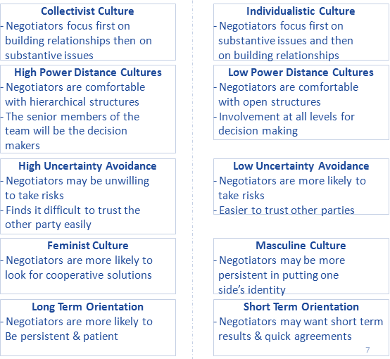

Slide 19
Study of country negotiation styles by John Graham – looked at businesspeople in 16 countries over a period of 15 years
Verbal negotiating tactics were analyzed in this study :
Promise
Threat
Recommendation
Warning
Reward
Punishment
Positive appeal
negative appeal
commitment
Question
Command
Use of no’s and ‘you’s
Non verbal behaviors such as silent Periods, interruptions, facial gazing and touching

Slide 20
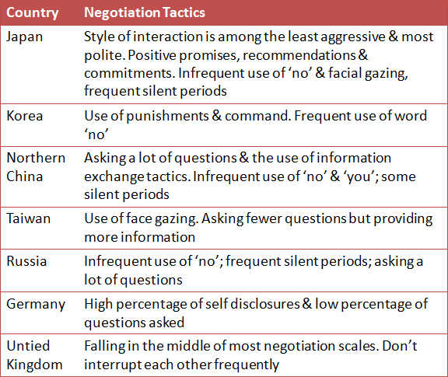
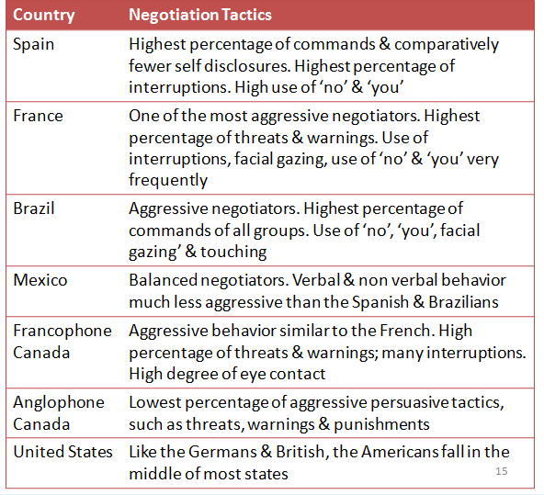

Slide 21
CULTURALLY RESPONSIVE NEGIATION STRATEGIES
A culturally responsive strategy is one that aligns both the parties’ negotiating styles and brings about a mutually coherent form of negotiator interaction.
Process which can be followed :
Step 1 : Reflect on the Negotiation Styles of your own Culture and Counterpart’s Culture
Step 2 : Consider the Relationship and Circumstances
Step 3 : Choose your Strategy

