Slide 1
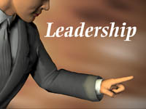

Slide 2
This work is licensed under a Creative Commons Attribution-ShareAlike 4.0 International License. This presentation is released under Creative Commons-A6ribute,on 4.0 License. You are free to use, distribute and modify it ,
including for commercial purposes, provided you acknowledge the source.

Slide 3
Meaning
The ability to influence a group toward the achievement of a particular goal.

Slide 4
THEORIES
TRAIT THEORIES
GHISELLI’S PERSONAL TRAITS
2) BEHAVIOURAL THEORIES
- MICHIGAN STUDIES
MANAGERIAL GRID
3) CONTINGENCY/ SITUATIONAL THEORIES
PAUL HERSEY & BLANCHARD THEORY
PATH-GOAL THEORY

Slide 5
TRAIT THEORY
-The trait theory of leadership focuses on the individual characteristics of successful leaders.
Leaders possess a set of traits which make them distinct from followers.
It rests on the traditional approach which describes leadership in terms of certain personal and special characteristics which are not acquired by knowledge and training but are considered inherited.
Leaders are born and not made.

Slide 6
GHISELLI’S PERSONAL TRAITS
He studied 300 managers from 90 different companies and his findings suggest that the following personality traits range from Very Important to Unimportant in relation to leadership success.
VERY IMPORTANT: Decisiveness , Intellectual Capacity, Job Achievement orientation, self actualization feelings, self- confidence, team builder.
MODERATELY IMPORTANT: Affinity for working class, Drive & initiative, need for a lot of money, need for job security, Personal maturity.
NOT IMPORTANT: Gender difference.
Problem with Ghiselli’s research is that several traits are interdependent and there is no indication of how much of any trait a person should have to be an effective leader.

Slide 7
BEHAVIOURAL THEORIES
According to the behavioural approach to leadership, it is not the characteristics of the leader but rather the way the leader behaves towards followers that determines effectiveness.

Slide 8
The Michigan Studies
Linkert carried out a research to identify styles of leader behavior that
result in increased work-group performance and satisfaction .
These studies resulted in the development of
two distinct styles of leadership
Employee Oriented:
Emphasize interpersonal relations
Took a personal interest in needs of their employees
Emphasized delegation of authority
Employee’s need advancement and personal growth.
2) Production Oriented:
Such leaders emphasize the technical/ task aspects of the job.
Main concern was accomplishing their group’s task.
Used rules, procedures and close supervision of subordinates.
Conclusion: favoured strongly the leaders who were EO.
They lead to higher group productivity and Higher job satisfaction

Slide 9
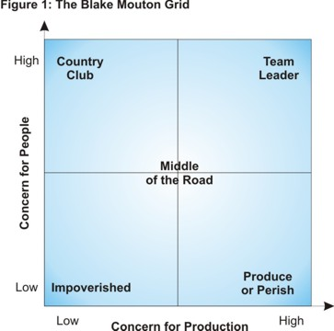
Managerial Grid
Developed by Blake and Mouton
They proposed a Managerial Grid based on the styles of
‘Concern for People’
‘Concern for production’

Slide 10
Concern For Production
Means the attitudes of Superiors towards
Quality of Policy decisions
Procedure and Processes
Creativeness of Research
Work efficiency
Volume of output

Slide 11
Concern for People
Degree of personal commitment towards -
goal achievement,
maintaining the self- esteem of workers,
responsibility and
satisfying inter-personal relations.

Slide 12
The Managerial Grid model emphasized that both concerns should be integrated to achieve the objectives of the organization.
The Managerial Grid is built on two axis, one representing the ‘People’ and the other the ‘Task’.
Both horizontal and vertical axis are treated as a scale from 1 to 9 where,
‘1’ represents the Least Involvement & ‘9’ represents the most involvement
Blake and Mouton have identified 5 co-ordinates that reflect various styles of leader behavior.

Slide 13
5 co-ordinates

Slide 14
5 Co-ordinates ( STYLES OF LEADER BEHAVIOR)
TASK (9,1):- Max. concern for production and Min. concern for people.
- Such leaders maximize production by using authority and power to achieve control over subordinates.
-Minimum worker interference
Gives detailed instructions
Supervise closely to make sure their directives are properly carried out.
Requires unquestioning obedience
No attention on development and communication with the employees.

Slide 15
5 Co-ordinates ( STYLES OF LEADER BEHAVIOR)
COUNTRY CLUB (1,9):- Max concern for People and Minimum concern for production
Involves Personal and Meaningful relationships with people.
Friendly atmosphere and high morale
Loosely structured work design

Slide 16
5 Co-ordinates ( STYLES OF LEADER BEHAVIOR)
IMPOVERISHED (1,1):- MIN. Concern for production and MIN. Concern for People.
Manager makes minimum efforts to get the work done.
Minimum standards of performance and minimum worker dedication.
He passes on the blame to others for failures

Slide 17
5 Co-ordinates ( STYLES OF LEADER BEHAVIOR)
TEAM (9,9):- Max. Concern for production and Max. Concern for People
This style is ultimate in managerial efficiency
These are thoroughly dedicated people
There is trustworthy, respectable atmosphere
This brings about the kind of team spirit that leads to high organization accomplishment

Slide 18
5 Co-ordinates ( STYLES OF LEADER BEHAVIOR)
MIDDLE ROAD (5,5):-Moderate concern for people and Moderate concern for production.
The ‘people’ dimension in work is as important as ‘production’ dimension
This seeks a balance between the two
Meetings are held to listen to the suggestion of subordinates and to create a sense of belonging.
Conclusion:
Most desirable leadership behavior is 9,9 (Team)

Slide 19
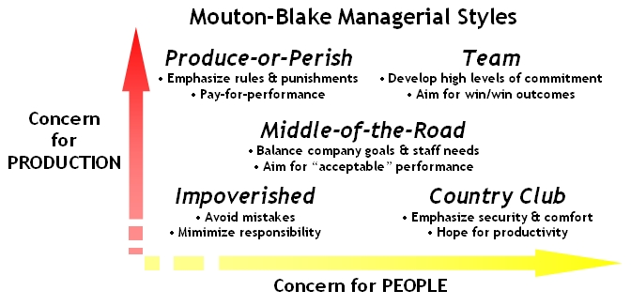

Slide 20
CONTINGENCY THEORIES
Situational Leadership theory (SLT) or Hersey and Blanchard Theory

Slide 21
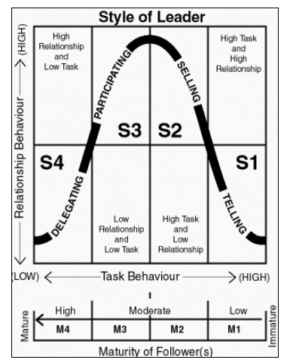

Slide 22
FIEDLER’S CONTINGENCY LEADERSHIP Least preferred co-worker scale
Unfriendly | 1 2 3 4 5 6 7 8 | Friendly
Unpleasant | 1 2 3 4 5 6 7 8 | Pleasant
Rejecting | 1 2 3 4 5 6 7 8 | Accepting
Tense | 1 2 3 4 5 6 7 8 | Relaxed
Cold | 1 2 3 4 5 6 7 8 | Warm
Boring | 1 2 3 4 5 6 7 8 | Interesting
Backbiting | 1 2 3 4 5 6 7 8 | Loyal
Uncooperative | 1 2 3 4 5 6 7 8 | Cooperative
Hostile | 1 2 3 4 5 6 7 8 | Supportive
Guarded | 1 2 3 4 5 6 7 8 | Open
Insincere | 1 2 3 4 5 6 7 8 | Sincere
Unkind | 1 2 3 4 5 6 7 8 | Kind
Inconsiderate | 1 2 3 4 5 6 7 8 | Considerate
Untrustworthy | 1 2 3 4 5 6 7 8 | Trustworthy
Gloomy | 1 2 3 4 5 6 7 8 | Cheerful
Quarrelsome | 1 2 3 4 5 6 7 8 | Harmonious

