Slide 1
Strategic Human Resource Management

Slide 2
What is Strategy?
Strategy is a term that comes from the Greek word strategia, meaning "generalship."
In the military, strategy often refers to manoeuvring troops into position before the enemy is actually engaged.

Slide 3
What is Strategy?: The company’s long term plan for how it will balance its internal strengths and weaknesses with its external opportunities and threats to maintain a competitive advantage
What is Strategic Management?: the process of identifying and executing
the organization’s mission by
matching its capabilities with the demands of its environment

Slide 4
Strategic Management Process
Strategic analysis
Environmental analysis
Establish organizational direction
Strategy formulation
Strategy implementation
Strategic control

Slide 5
Strategic HRM
Strategic HRM is to ensure that human resource management is fully integrated into strategic planning
The HRM policies cohere (join together) both across policy areas and across hierarchies and that HRM policies are accepted and used by the line managers as part of their work
The term HR strategy & Strategic HRM are often used interchangeably, but a distinction can be made between them

Slide 6
Strategic HRM
HR Strategy
Strategic HRM can be regarded as general approach to the strategic management of human resources in accordance with the intentions of the organization on the future direction
It is concerned with long term people issues as a part of the strategic management process of the organization
What emerges from this process is a stream of decision over time that forms the patterns adopted by the organization for managing its HR and defines the areas in which specific HR strategies need to be developed
It deals with macro concerns about structure, values, culture, quality, commitment, performance, competence & management development
It focuses on the specific intentions of the organization as to what needs to be done and what needs to be changed

Slide 7
Strategic HRM & HR strategy can be compared with the relationship between strategic management & corporate business strategies
Strategic HRM & strategic management are terms describing an approach that may be adopted by top management & focuses on longer term & setting the overall direction
HR strategies and corporate/business strategies can be outcome of this approach, which specify in more detail the intentions of the org. concerning key issues and particular functions and activities

Slide 8
Strategic integration is necessary to provide congruence between business and human resource strategy, so that the latter supports the accomplishment of the former and indeed helps to define it
The aim is to provide strategic fit and consistency between the policy goals of HRM & the business

Slide 9
Concept & Meaning of SHRM
The concept of strategic HRM was first formulated by Fombrunet who wrote that three core elements are necessary for firms to function effectively
Mission & strategy
Organization Structure
Human Resource Management
The success of an organization depends on the people therein. This means how they are acquired, developed, motivated & retained in the organization, plays an important role in the organization success
This proposes an integral approach towards HR functions and overall business functions of an organization
Thus strategic HRM means a strategic look at HR functions in line with the business functions of an organization

Slide 10
Strategic HRM therefore is concerned with the following;
Analyze the opportunities and threats existing in the external environment
Formulate strategies that will match the organizations (internal) strengths and weaknesses with the environmental (External) threats and opportunities. In other words SWOT analysis of organization
Implement the strategies so formulated
Evaluate & control activities to ensure that organizations objectives are duly achieved

Slide 11
Aims & Objectives
To generate strategic capability by ensuring that the organization has the skilled, committed and well-motivated employees – by which it need to achieve sustained competitive advantage
To provide a sense of direction in an often turbulent environment so that the business needs of the organization and the individual and collective needs of its employees can be met by the development and implementation of coherent and practical HR policies & programmes

Slide 12
Significance/Importance of SHRM
When a human resource department strategically develops its plans for recruitment, training, and compensation based on the goals of the organization, it is ensuring a greater chance of organizational success
Ex. - Let's think about this approach in relation to a basketball team. The whole team wants to win the ball game, and they all may be phenomenal players on their own, but one great player doesn't always win the game. That's not how a basketball team wins, and it's not how an organization wins either. A team wins when its members support each other and work together for a common goal
You could also look at strategic HRM as the team captain or coach, as his or her responsibilities are a little bit different from those of the other players.
Human resources departments are charged with analyzing the changes that need to occur with each 'player' or department and assisting them in strengthening any weaknesses.
Strategic human resource management then is the process of using HR techniques, like training, recruitment, compensation and employee relations to create a stronger organization

Slide 13
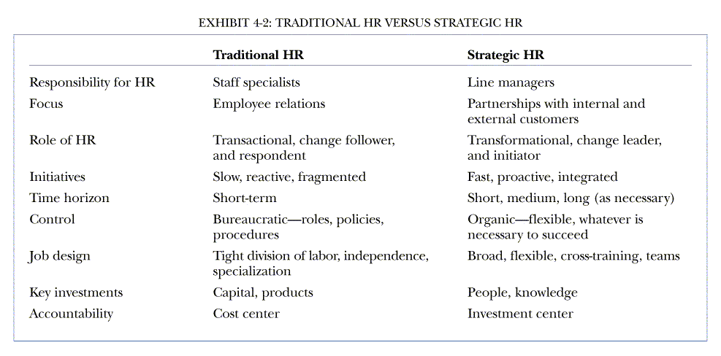
Traditional HR versus Strategic HR

Slide 14
Some Examples
Southwest airlines – Ticketless travel
Albertson – Superior managers shape their department policies & practices – so that they make sense in terms of (or align with ) their companies strategic aims
Main purpose of SHRM is to show how to develop a HR manager that supports and make sense in terms of your company’s strategic aims

Slide 15
Way forward in SHRM
Here we will see how to translate a companies business strategy into actionable human resource policies & practices
We will see strategic management process
How to develop a strategic plan
The HR managers role in strategic management process &
A step by step ‘HR Scorecard approach to create HR policies & practices that makes sense in terms of the company’s strategic aims

Slide 16
Ford motor company, faced huge loss & hemorrhaging market share to TOYOTO & NISSAN, knew it needed a new strategic plan
Competition was tight, Ford’s cost was too higher than competitors, Fords unused plant capacity was draining profits
Fords manager devised ‘The way forward’ – this new strategic plan established closing a dozen plants & terminating 20,000 employees
This was a strategic plan of how it will match internal & strength & weakness to external Opportunities & threats

Slide 17
The essence of strategic planning is to ask
Where are we now as a business?
Where do we want to be?
& How should we get there?
The managers the formulate specific strategies to take the company from where it is now to where he or she wants to be.

Slide 18
SHRM - some more details
Managers use the term ‘HR Strategy” to refer to the specific HRM courses of action the company pursues to achieve its strategic aims
Ex. FedEx strategic aim is to achieve superior levels of customer service & high profitability through a highly committed workforce. Preferably in a non union environment
FedEx HR strategies stem from this aim
They include using various tools to build two-way communication
Screening out potential managers whose values are not people oriented
Guaranteeing to the greatest extent possible fair treatment & employee security for all employees
& utilizing various promotion from within activities to give employess every opportunity to fully realize their potential to give every opportunity to fully realize their potential

Slide 19
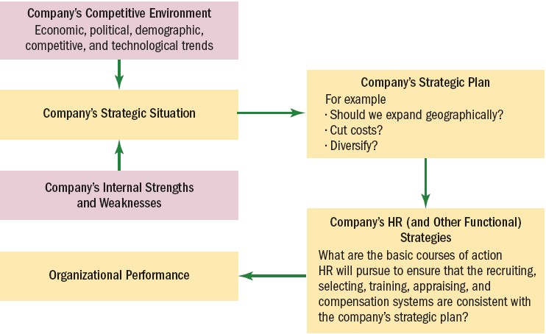
Linking Corporate and HR
Strategies

Slide 20
SHRM means formulating & executing HR policies & practices that produce the employee competencies & behaviours the company needs to achieve its strategic aims
Ex. Southwest Airlines – Keeps its price low
Southwest real secret is its HR management strategy
Southwest aim is to deliver low cost, convinient service
on short haul routes
How do they do this?
One big way is by getting fast, 15 min turnaround at the gate, thus keeping planes flying longer hours than rivals
What employee competencies and skills does
southwest need for these fast turnarounds
Ground crews, gate employees & even pilots who all pitch in & do whatever it takes to get planes turnaround

Slide 21
& HR management policies & practices would produce such employee competence & behaviors
HR strategy built on high compensation, flexible job assignments, cross training & employee stock ownership
1)High compensation, flexible work assignments & so forth lead to 2) motivated flexible ground crews & employee who do whatever it takes to 3) turn the planes around in 15min, so that 4) southwest achieves its strategic aims of delivering low cost, convenient service

Slide 22
Ex Dell – its strategy is always been to be a low cost leader
Dells HR Manager use various HR strategies to support Dells low cost aims
Ex. Dell delivers most of its HR services, not through conventional HR dept, but via the Web – i.e a managers tool on Dell intranet contains about 30 automated web application
Instead top management needs the input of HR team in designing the strategy, since it is the team charged with Hiring, training & compensating the firms employees
HR managers will therefore need an IN DEPTH understanding of the value creating proposition of the firm (In other words, a basic functional understanding of the firm makes money)

Slide 23
What activities & processes are most critical for value creation as defined by customers & capital market?
Who in the firm executes these activities successfully?
HR professional needs to understand the basic business functions such as Accounting, finance, production & Sales.. So they can take their seat at the table (HR ADVOCATES) when top management is crafting the firms strategic plan

Slide 24
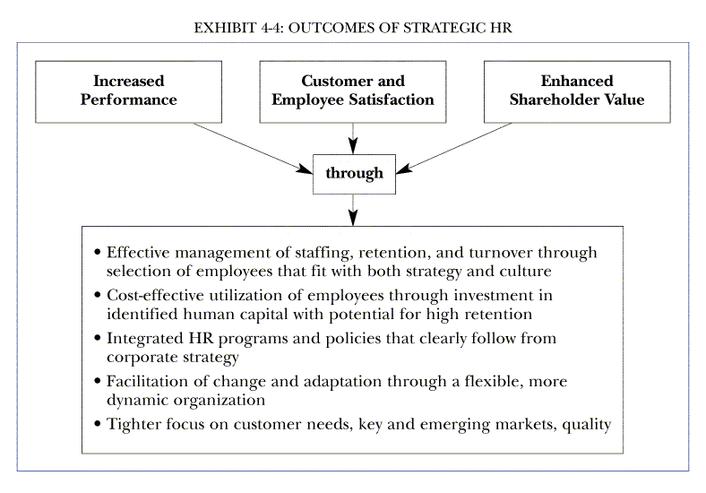

Slide 25
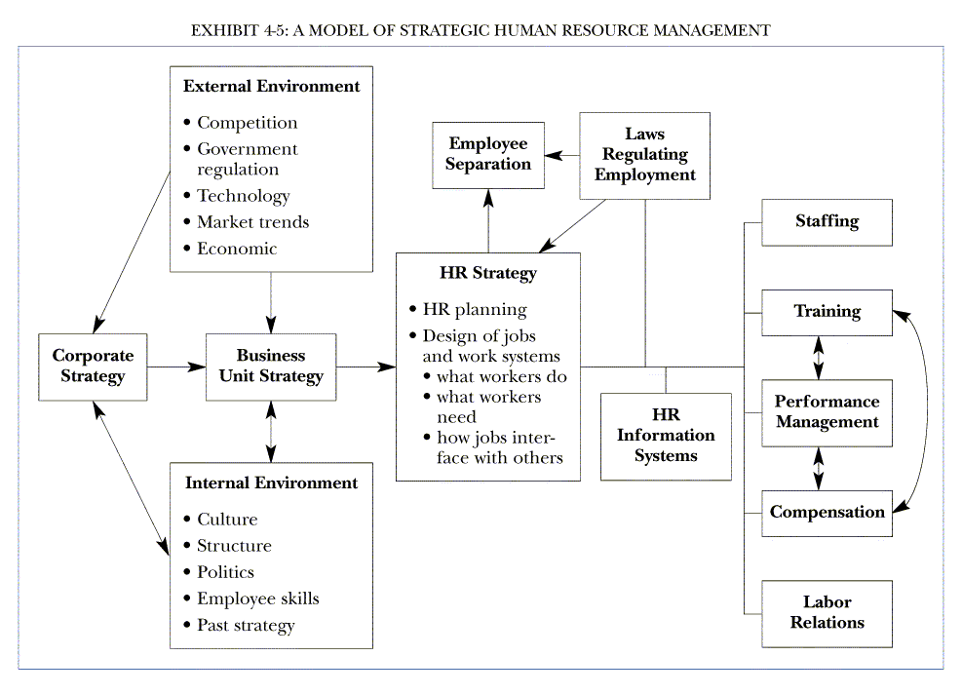

Slide 26
HR’S Strategic Roles
HR professionals should be part of the firm’s strategic planning executive team.
Identify the human issues that are vital to business strategy.
Help establish and execute strategy.
Provide alternative insights.
Are centrally involved in creating responsive and market-driven organizations.
Conceptualize and execute organizational change.

Slide 27
HR’s Strategy Formulation Role
HR helps top management formulate strategy in a variety of ways by.
Supplying competitive intelligence that may be useful in the strategic planning process.
Supplying information regarding the company’s internal human strengths and weaknesses.
Build a persuasive case that shows how—in specific and measurable terms—the firm’s HR activities can and do contribute to creating value for the company

Slide 28
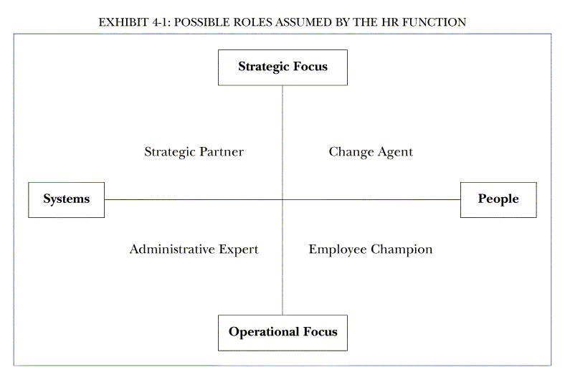

Slide 29
The Basic Architecture of HR

Slide 30
5P Model of Strategic HRM
The 5 Ps model of strategic human resource management (SHRM) is a new model in the area of study.
This model is proposed by Randal.
Schuler this model melds five human resource activities with strategic highlight just how significant, the strategy activity link can be.
The proposed model incorporates the 5 Ps of strategic
human resource management which stand for
Philosophy of Human resources
Policies human resources
Programme of human resources
Practices of human resources
Processes of human resources

Slide 31
1. Philosophy: Expressed in statements defining business values and culture. It expresses how to treat and value people.
2. Policies: Expressed as shared values and guidelines. Policies establish guidelines for action on people related business issues and HR programs.
3. Programs: These coordinate efforts to facilitate change to address major people related business issues.
4. Practices: For leadership managerial and operational role practices motivate needed role behaviors.
5. Processes: For the formulation and implementation of other activities these define how activities are carried out.

Slide 32
The Five P’s Model of SHRM
Successful SHRM efforts begin with identification of strategic needs
Employee participation is critical to linking strategy & HR practices
Strategic HR depends on systematic & analytical mindset
Corporate HR departments can have impact on organization’s efforts to launch strategic initiatives

Slide 33
HUMAN RESOURCES PHILOSOPHY
This is a statement of how the organization regards its human resources, what role the resources play in the overall success of the business, and how they are to be treated and managed.
Instead of using the terms HR philosophy or HR values to describe how human resources are regarded, treated, and managed, some organizations use the term culture.

Slide 34
HUMAN RESOURCES POLICIES
All of these statements provide guidelines for action on people-related business issues and for the development of HR programs and practices based on strategic needs. The term HR Policy, as used here, does not mean HR Policy Manual.

Slide 35
HR policy can link values with a particular people-related business need
Values: high standards of personal performance
Need: to develop communication skills that would foster such performance in a decentralized international environment
HR policy: instant feedback. if you have a problem or an idea about any aspect of the business, or about an individual's performance, then the organization demands that you raise the issue appropriately and discuss it maturely.

Slide 36
HUMAN RESOURCES PROGRAMS
Shaped by HR policies, HR programs represent coordinated HR efforts specifically intended to initiate, disseminate, and sustain strategic organizational change efforts necessitated by the strategic business needs.

Slide 37
Generic questions help to identify the fundamental issues for programs
What is the nature of the corporate culture? Is it supportive of the business?
Will the organization be able to cope with future challenges in its current form?
What kind of people and how many will be required?
Are performance levels high enough to meet demands for increased profitability, innovation, higher productivity, better quality, and improved customer service?
What is the level of commitment to the company?
Are there any potential constraints such as skill shortages or HR problems?

Slide 38
HUMAN RESOURCES PRACTICES
LEADERSHIP ROLES
Establishing direction
Aligning people
Motivating and inspiring individuals
Causing dramatic and useful change

Slide 39
MANAGERIAL ROLES
Make sure that objectives are clearly understood
Level with people on what is not negotiable
Give appropriate orientation to people on new assignments
Deal effectively with performance problems
Give people the information they need to be successful
Give developmental performance feedback in a timely manner
Give people the freedom they need to do their jobs
Give co-workers the opportunity to try out their new ideas
Encourage appropriate collaboration on work assignments
Encourage people to participate when appropriate
OPERATIONAL ROLES
Content is far more specific than for the other roles

Slide 40
HUMAN RESOURCES PROCESSES
This area deals with "how" all the other HR activities are identified, formulated, and implemented.

Slide 41
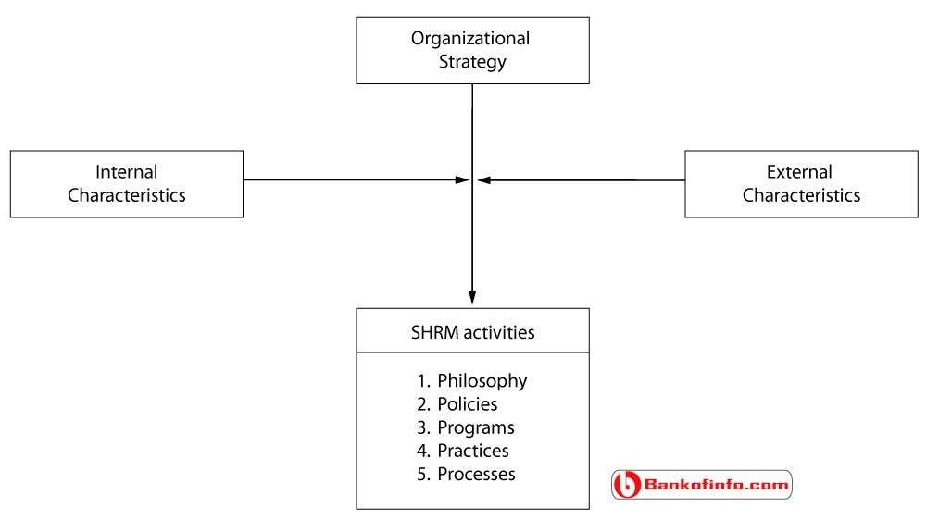
5P Model of SHRM

Slide 42
The main purpose of SHRM is to show you how to develop a human resource management system that supports, and makes sense in terms of, your company’s strategic aims;
Here we show how to translate a company’s business strategy into actionable human resource policies & practices

Slide 43
Strategic Human Resource Management Tools
Following are the three important Human Resource Management Tools;
STRATEGY MAP
THE HR SCORECARD
DIGITAL DASHBOARD

Slide 45
Strategy Map
The strategy map shows the ‘big picture’ of how each departments performance contributes to achieving the company’s overall strategic goals
It helps the manager understand the role his or her department plays in helping to execute the company’s strategic plan
Ex. In case of Southwest Airline – has a low cost leader strategy. The strategy map for Southwest succinctly (in brief) lays out the hierarchy of main activities required for Southwest airlines to succeed
At the top is achieving company wide strategic financial goals.
Then the strategy map shows the chain of activities that help Southwest airlines achieve this goals
For example: to boost revenues and profitability, Southwest needs to fly fewer planes (to keep costs down), maintain low prices and maintain on time flights.
In turn (further down the strategy map), on-time flights and low prices require fast turnaround
And fast turn around requires motivated ground and flight crews
The strategy map helps each department (including HR) visualize
what it needs to do to support Southwest’s low cost strategy

Slide 46
Strategy Map: Example – Southwest Airlines
What overall goals does Southwest Airlines want to achieve?
Improve market share from 32% to
Maintain profit growth of 4% per
38%
year
Maintain industry wide low prices
What must Southwest do operationally to achieve these goals?
Fly fewer planes (Maximize passenger miles
flown per seat)
Maximize on-time flights
Turnaround planes at gates in 20
minutes
Highly committed employees who are willing to “go the extra miles” for southwest Airlines
What employee attitudes and behaviors will produce these operational outcomes

Slide 49
The HR Scorecard
A tool that helps managers measure what matters to a company.
Developed by Robert Kaplan and David Norton,
the Balanced Scorecard helps managers define the
performance categories that relate to the company’s strategy.
The managers then translate those categories into metrics and track performance on those metrics.
Besides traditional financial and quality measures, companies use employee-performance measures to track their employees’ knowledge, skills, and contributions to the company.
The employee-performance aspects of the Balanced Scorecard analyze employee capabilities, satisfaction, retention, and productivity.
Companies also track whether employees are motivated (e.g., by tracking the number of suggestions made and implemented by employees) and whether employee performance goals are aligned with company goals.

Slide 50
Applying the Balanced Scorecard Method to HRM
Because the Balanced Scorecard focuses on the strategy and metrics of the business, Mark Huselid and his colleagues took this concept a step further and developed the Workforce Scorecard to provide a framework specific to HRM.
According to Huselid, the Workforce
Scorecard identifies and measures the behaviors, skills, mind-sets, and results required for the workforce to contribute to the company’s success.
Specifically, as summarized in the following figure, the Workforce Scorecard has four key sequential
Workforce mind-set and culture. Does the workforce understand the strategy and embrace it? Does the workforce have the culture needed to support strategy execution?

Slide 51
Workforce competencies. Does the workforce, especially in the strategically important or “A” positions, have the skills it needs to execute the strategy? (Remember that “A” positions are
those job categories most vital to the company’s success.)
Leadership and workforce behaviors. Are the leadership team and workforce consistently behaving in ways that will lead to the attainment of the company’s key strategic objectives?
Workforce success. Has the workforce achieved the key strategic objectives for the business? (If the organization can answer yes to the first three elements, then the answer should be yes here as well.)

Slide 52
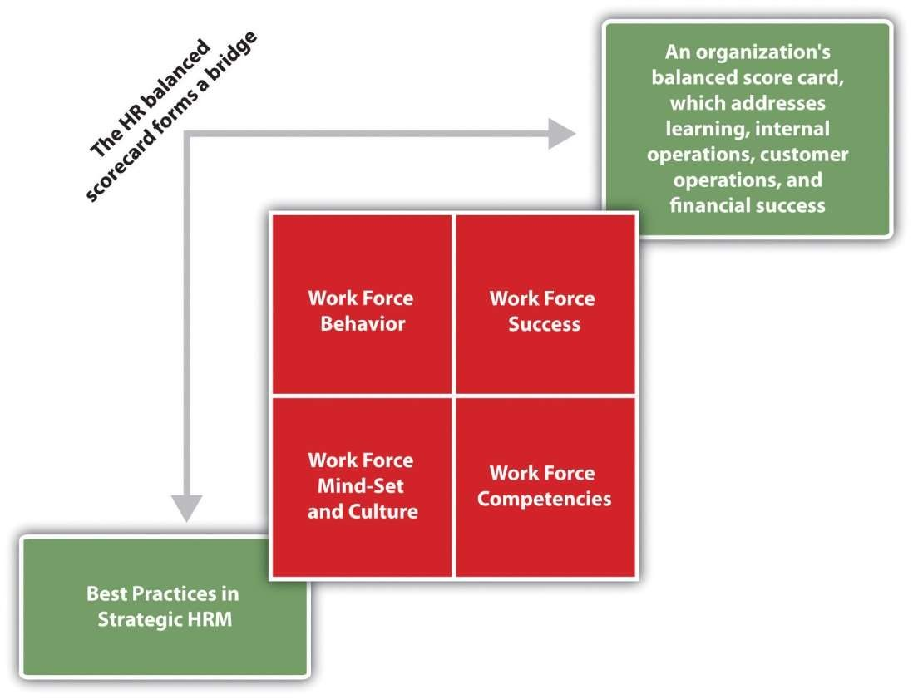
The workforce balanced scorecard

Slide 53
Implementing the Workforce Scorecard requires a change in perspective, from seeing people as a cost to seeing people as the company’s most important asset to be managed—human capital.
Human capital is the collective sum of the attributes, life experiences, knowledge, inventiveness, energy, and enthusiasm that a company’s employees choose to invest in their work.
Such an asset is difficult to measure because it’s intangible, and factors like “inventiveness” are subjective and open to interpretation.
The challenge for managers, then, is to develop measurement systems that are more rigorous and provide a frame of reference.

Slide 54
The metrics can range from activity-based (transactional) metrics to strategic ones.
Transactional metrics are the easiest to measure and include counting the number of new people hired, fired, transferred, and promoted.
The measures associated with these include the cost of each new hire, the length of time and cost associated with transferring an employee, and so forth.
Typical ratios associated with transactional metrics include the training cost factor (i.e., the total training cost divided by the number of employees trained) and training cost percentage (i.e., the total training cost divided by the operating expense)

Slide 55
But these transactional measures don’t get at the strategic issues—namely, whether the right employees are being trained and whether they’re remembering and using what they learned.
Measuring training effectiveness requires not only devising metrics but also changing the nature of the training.
The Balanced Scorecard, when applied to HRM, helps managers align all HRM activities with the company’s strategic goals. Assigning metrics to the HRM activities lets managers track progress on goals and ensure that they’re working toward strategic objectives. It adds rigor and lets managers quickly identify gaps.

Slide 56
Companies that measure intangibles such as employee performance, innovation, and change perform better financially than companies that don’t use such metrics.
Rather than investing equally in training for all jobs, a company should invest disproportionately more in developing the people in the key strategic (“A”) jobs on which the company’s success is most dependent.

Slide 58
Digital Dashboard
The saying “a picture is worth a thousand words” explains the purpose of the digital dashboard
A dashboard presents the managers with desktop graphs and charts, and so a computerized picture of where the company stands on all those metrics from the HR scorecard process
As in the illustration just below, a top manager’s dashboard for southwest airlines might display on the PC screen real-time trends for strategy map activities such as fast turnaround, attracting and keeping customers and on-time flights
This gives the manager time to take corrective action
For example: if ground crews are turning planes around slower today, financial results tomorrow may decline the manager takes action

Slide 59
A digital dashboard is an electronic interface used to acquire and consolidate data across an organization.
A digital dashboard provides in-depth business analysis, while providing a real- time snapshot of department productivity, trends and activities and key performance indicators, etc.
A digital dashboard is also known as a dashboard, traffic dashboard and traffic dash

Slide 60
Translating strategy into human resource policies & practices
Strategic human resource management means formulating and executing human resource policies & practices that produce employee competencies and behaviors the company needs to achieve its strategic aims
The HR manager therefore needs a practical way to translate the company’s strategy into required employee competencies and behaviors, and to translate these required employee competencies into specific human resource policies & practices that will produce them
Management formulates a strategic plan. That strategic plan implies certain workforce requirements, in terms of employee skills, attributes and behaviors that HR must deliver to enable the business to achieve its strategic goals (ex. For improving customer service we need more of computer literate to run the machines)
Given these workforce requirements, HRM formulates HR strategies, policies & practices it believes will produce the desired workforce, skills, attributes & behaviors (these may take the form of new selection, training and compensation policies and practices for instance)

Slide 61
Finally human resource manager identifies scorecard measures (metrics) he or she can use to measure the extent to which its new policies & practices are actually producing the required employee competencies and skills, and thus supporting managements strategic goals
Example : Albertsons (is an American Grocery company)
How could Albertsons Human resource team help the company control costs and hire customer focused employees?
At Albertsons, reducing personnel-related costs and improving performance meant hiring employees who had a customer focused approach and reducing turnover, improving retention, and eliminating time-consuming manual processes and procedures for store managers
Working with its information technology department, Albertsons human resource management team chose a system from Unicru of Portland. The system collects and analyses the information entered by the applicants online and at kiosks

Slide 62
It ranks applicants based on the extent to which they exhibit the customer-focused traits that predict success in retail jobs, helps track candidates throughout the screening process, and does other things, such as track reason for departure once applicants are hired
Human resource managers were able to present a compelling business case to indicate the new systems return on investment
Working as a partner in ‘Albertsons’ strategy design and implementation process , the human resource team helped Albertsons achieve its strategic goals, by helping to control costs & hire customer-focused employees

Slide 63
Translating strategy into HR Policies & Practices
Formulate business strategy
Identify workforce measurement
Formulate HR strategic policies and activities
Develop detailed HR scorecard measures

Slide 65
Translating strategy into human resource policies & practices: An example
An organizational change effort at the Albert Einstein healthcare network (Einsten Medical) illustrates how companies translate strategic plans into human resource policies and practices
In the 1990, it was apparent to einsten’s new CEO that intense competition, scientific technological changes, the growth of managed care, and significant cuts in Medicare and medicaid meant that his company needed a new strategic plan
At the time, Einsten medical was a single acute care hospital, treating the seriously ill
New strategy: the essence of the CEO’s new strategy was to change Einsten into a comprehensive health care network of facilities providing full range of high quality services in various local markets

Slide 66
He knew that achieving this change in strategy would require numerous changes in Einstein Medical’s organization and employee behaviours,.
In particular, given the highly dynamic and uncertain health care environment , the new einsten medical would require a much more flexible, adaptable and professional approach to delivering services
Based on that, he decided to summarize the strategic goals of his change program in three words: “INITIATE”, “ADAPT”, AND “DELIVER”
To achieve Einstein Medicals strategic aims, its HR and other strategies would have to help the medical centre and its employees to produce new services (Initiate), capitalize on opportunities (Adapt) and offer consistently high quality services (Deliver)

Slide 67
New employee competencies and behaviors: the CEO’s next question was, “what sorts of employees competencies, skills and behaviors would Einsten Medical need to produce these three outcomes?”
Working with the Head of HR the ceo chose four employee skills & behviors: Einsten employees would need to be “dedicated, accountable, generative and resilient” they would have to be dedicated to einstens focus on INITIATE, ADAPT and DELIVER
They would have to take personnel accountability for their results
They would have to be generative, which means able and willing to apply new knowledge and skills in a constant search for innovative solutions.
And they would have to be resilient for instance, in
terms of moving from job to job as the company ‘s need changed

Slide 68
New Human Resource Policies & practices:
Given these desired employee competencies and behaviors, Einstein medical’s Human resource managers could ask, “ what specific HR policies and practices would help Einstein create a dedicated, accountable, generative and resilient workforce and thereby help it achieve its strategic goals?
The answer was to implement several new human
resource programs:
New training and communication programs aimed at assuring that employees clearly understood the company’s new vision and what it would require of all employees
Enriching work involved providing employees with more challenge and responsibility through flexible assignments and team based work
New training & benefits programs promoted personal growth, which meant helping employees take personal responsibility for their own improvement & personal development

Slide 69
Providing commensurate returns involved tying employees’ rewards to organization wide results and providing nonmonetary rewards (such as more challenging job)
Improved selection, orientation and dismissal procedures also helped Einstein build a more dedicated, resilient, accountable and generative workforce
In sum, Einstein managers translated the new strategy into specific human resource policies & practices. They knew they could not execute their new strategy without new employee competencies and behaviors.
In turn, promoting these competencies and behaviors required implementing new human resource policies & practices
They could then choose measures (such as “hours of training per employee per year”) to monitor the new strategies actual progress
Einstein medicals managers used a simple, logical and subjective process to translate strategy into required human resource policies & practices and activities.
This is perfectly acceptable. Increasingly, however many
companies are turning to more rigorous methodology called

