Slide 1
COMMUNICATION ACROSS CULTURE
1
Chapter 4

Slide 2
2
Chapter 4
WHAT IS COMMUNICATION?
“Communication describes the process of sharing meaning by transmitting messages through media such as words, behavior, or material artifacts.”
Prentice Hall 2003
Three Basic Steps :
Individual
Group
Organization

Slide 3
CROSS- CULTURAL COMMUNICATION
3
Chapter 4 Prentice Hall 2003
(also frequently referred to
as intercultural communication)
“Its seek to understand how people from different countries and cultures behave, communicate and perceive
the world around them cultures”

Slide 4
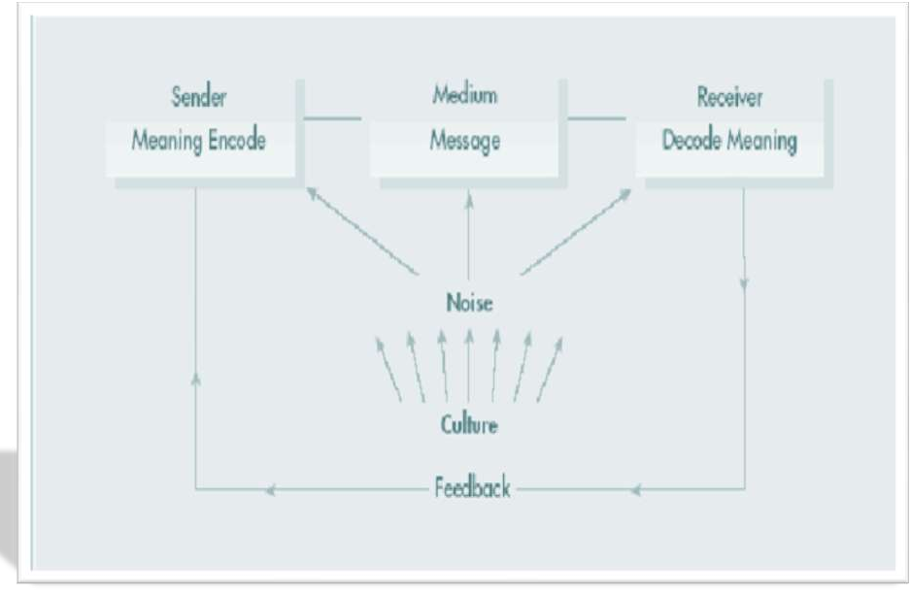
_{THE COMMUNICATION PR}Cha_{O}pter 4 _{C}Pren_{E}tice Hal_{S}l 2003_{S}
4

Slide 5
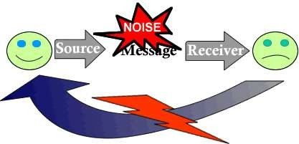
5
Chapter 4
Prentice Hall 2003
NOISE
“Anything that interferes with,
slows down, or reduces the clarity or accuracy of a
communication. ”
Noise can be external or internal, and it can disrupt the communication process at any point.

Slide 6
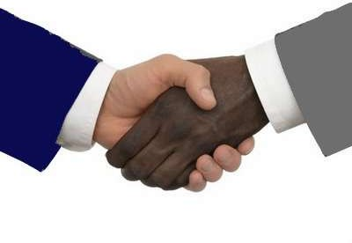
IMPORTANCE OF CROSS-CULTURAL
6
COMMUNICATION
Cross-cultural communication in business happens between any two companies regardless of their location. To effect productive business relationships, every organization needs to be sensitive to the potential issues of cross-cultural communication

Slide 7
1. Common Ground:
7
Prentice Hall 2003
When a company engages in cross-cultural communication, the first thing to establish is
the common ground with the new business partner. It begins with the most effective ways to communicate. Breaking through on common ground can help the two sides to establish a productive dialogue that will enhance the business relationship.
2. Informational Context:
Different corporate cultures require different levels of information. Developing the proper informational context is critical when communicating with a new business partner, and it begins by understanding the work culture of your business partner and how information is processed.

Slide 8
8
Chapter 4
Prentice Hall 2003
Trust:
When a new business partner takes the time and effort to establish good cross-cultural communication, it helps to elevate the level of trust and respect between the two partners.
Respect for other companies' business processes is critical in establishing an efficient work relationship.
Quality:
Working within the guidelines of a new business partners corporate culture helps to improve communication at all levels of both organizations. The quality of the information improves when it is delivered in a manner that each company is accustomed to. Not only does the quality of the information passed between the two
companies improve, but the quality of the relationship with clients and other vendors that are affected by the relationship also improves.

Slide 9
_{T}Prentic_{I}e H_{N}all 200_{G}3
9
CULTURAL VARIABLES AFF^{C}E^{hapter}C⁴
COMMUNICATION
On a different level it is also useful to be aware of cultural variables that can affect the communication process by influencing a person’s perceptions. Some of these variables have been identified.
Attitude
Social organizations
Thought patterns
Roles
Language
Non-verbal communication
Time

Slide 10
10
Chapter 4
Prentice Hall 2003
Attitudes:
Attitudes underlie the way we behave and communicate and the way we interpret messages from other people. Ethnocentric attitudes are a particular source of noise in cross-cultural communication.
Social Organization:
Our perceptions can be influenced by differences in values, approach, or priorities relative to the kind of social organizations to which we belong.

Slide 11
11
Chapter 4
Prentice Hall 2003
Thought Patterns
Every culture have different thought patterns and logics towards anything vision and traditions are different from one another. Mostly depend on experience education and family background.
Roles: (manager’s perception)
Manager reflects the culture of its own organization. How manager perceive is very important, he should properly understood all the objectives. Wrong perception result in miscommunication

Slide 12
5. Language:
Spoken or written language is a frequent cause of miscommunication. accurate translation is a bridge to cover cultural gaps. language also conveys cultural and social understandings.
12
Chapter 4 Prentice Hall 2003
Time:
Another variable that communicates culture is the way people
regard and use time.
Mono-chronic time systems
It is related to time commitment .
Poly-chronic time systems:
Rather than giving importance to time this system gives priority to persons.

Slide 13
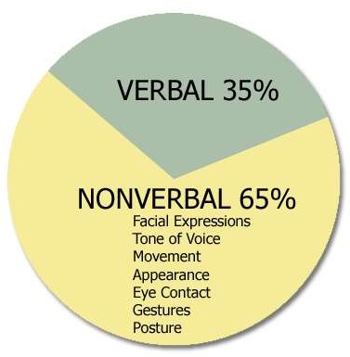
7. NONVERBAL COMMUNICATION:
13
Behavior that communicates without words. As it is said:
“A picture is worth a thousand words”
It includes:
Kinesics behavior
Proxemics
Paralanguage
Object/material

Slide 14
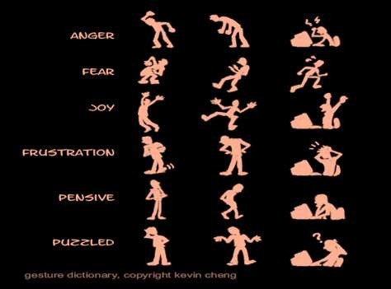
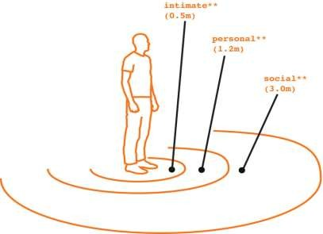
1. Kinesics behavior:
It refers to communication through body movement, postures, facial expressions, gestures and eye contact.
14
Chapter 4
Prentice Hall 2003
2. Proxemics:
It deals with the influence of power and space in communication.
High contact (minimizing the gaps and good understanding)
Low contact
(it prefers less involvement with each other)

Slide 15
15
3. Paralanguage:
It refers to how something is said rather than the content. for
e.g. The rate and tone of speech.
4. Object/material: Environment speaks through effects and material as how much object or product attracts the person. Such as office design, furniture, appearance, etc.
Chapter 4
Prentice Hall 2003

Slide 16
MANAGING CROSS-CULTURAL COMMUNICATION
16
Step towards effective inter cultural communication includes
Developing cultural sensitivity
Careful encoding
Selective transmission
Careful decoding of feedback
Follow-up actions

Slide 17
1. Cultural Sensitivity :
17
Encode the message in a form that will most likely be understood as it is intended
This means the manager must:
Be aware of their own culture
The recipient’s culture
The expectations surrounding the situation

Slide 18
2. Careful Encoding :
18
The sender must consider the receiver’s frame of reference to make the best choice regarding
Words
Pictures
Gestures
Remember that language translation is only part of the process, consider the nonverbal language as well

Slide 19
3. Selective Transmission :
19
The channel medium should be chosen after considering:
The nature of the message
Level of importance
Context and expectations of the receiver
Timing involved
Personal interactions

Slide 20
4. Careful Decoding of Feedback:
20
Best means for obtaining accurate feedback is face-to-face interactions
Best means for avoiding miscommunication is to improve your own listening and observation skills
Three types of miscommunications:
Receiver misinterpreted the message
Receiver encoded response incorrectly
Sender misinterprets the feedback

Slide 21
5. Appropriate Follow-Up Actions:(eye contact, posture, tone, etc)
21
Interaction posture – ability to respond in a descriptive, non-
evaluative, and non-judgmental way
Orientation to knowledge – understand that your beliefs and perceptions are only valid for you and not everyone else
Empathy

Slide 22
CULTURAL CONFLICT
22
Chapter 4
Prentice Hall 2003
Jonathan H. Turner defines it as:
“Differences in cultural values and beliefs that place people at odds with one another".
In another words, conflict may arise whenever there are cultural differences.

Slide 23
23
CAUSES OF CONFLICT
Chapter 4
Prentice Hall 2003
Misunderstandings through language, attitude and way of
communication.
Cultural ignorance and insensitivity
Lack of awareness of different societal lifestyle practices
Differences in cultural practice
Differences in perception
Misinterpretation can take place

Slide 24
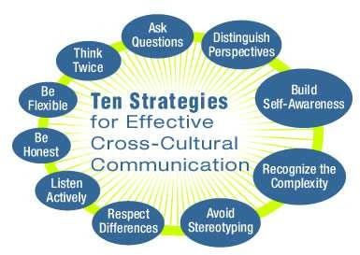
ACHIEVING CROSS-CULTURAL COMMUNICATION EFFECTIVENESS
24

Slide 25
CONCLUSION
25
Effective cross culture communication is a vital skill for international managers and domestic managers of multi cultural work forces because miscommunication is much more likely to occur among people from different countries or racial backgrounds that among those from similar background. So it is important to be alert to how culture is reflected in communication.

Slide 26
26
Chapter 4
Prentice Hall 2003

