Slide 1
CROSS-CULTURAL ISSUES
Dr.Shweta Lalwani
Assistant Professor
School of Management
Sir Padampat Singhania University, Udaipur

Slide 2
Culture: Meaning
‘Culture’ can be defined as the inherited values, symbols, language and ways of living which are shared by people of the same social group.

Slide 3
What differentiates various Cultures?
Various Dimensions perceived differently in different cultures:
Relationships
Equality
Time
Space
Spoken language and non-verbal communication
Risk-taking
Emotions
Rules and Regulations

Slide 4
Impact of Culture on Individual Behaviour
Professional Culture
Corporate Culture
Individual Behaviour
National Culture

Slide 5
The Critical Role of Culture
Why did one of the world’s biggest entertainment media companies, the world’s biggest retailer and world renowned Cereals and Convenience foods company struggled in their International ventures?

Slide 6
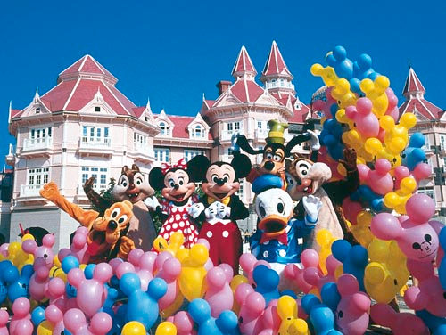
Euro Disney in Paris
1992: The Walt Disney Company, one of the world’s leading media and entertainment conglomerates, opens a new theme park named Euro Disney in Paris. It is Designed to be the biggest and most lavish Disney theme park in the world

Slide 7
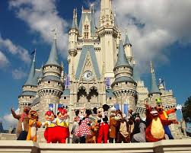
1994: Euro Disney incurs losses of $900 million since its opening; Euro Disney renamed Disneyland Paris. Many changes introduced. Fluctuating financial performance continues
2005 Disneyland Paris on the verge of Bankruptcy. The French government rescues Disneyland with a financial package.
2008 Disneyland shows its first profit in years.

Slide 8
Major Contributor to Disney’s poor performance in France
Lack of sensitivity to French and European culture. Imposition of ‘the American way’ in Disneyland Paris.
The Euro Disney restaurants did not have enough seating capacity. Europeans like eating their meals sitting down, unlike Americans who like to eat fast food on the move.
Euro Disney visitors did not use the expensive tram system on which Disney had invested millions of Dollars.
Alcohol was not served in Disney: drinking Wine was an integral part of the French culture.

Slide 9
Walmart in Germany
Some of the American employee management practices just didn’t fit in the German context.
Example: each employee before the shift had to participate in a morning exercise. In could be seen as harmless, but the best thing about this practice was that they had to do it chanting “WALMART! WALMART! WALMART!” . If in America such practice could be used to boost morale and inspire loyalty, then in Germany it was looked upon with annoyance.
The feedback of the employees was ignored. Top management apparently didn’t listen to anything the lower employees and subordinates had to say.

Slide 10
The lack of analysis of the local market and the specifics of local customers’ demands.
Example: store merchandising was wrong. Walmart put all premium products at eye level, while all the discount products were stored either at the bottom shelve or on the top one. This irritated German customers a lot.
The uprise of “greenness” in Germany. The ideas of conservation of environment and recycling were gaining momentum. Walmart’s plastic bags and redundancy of plastic packaging aroused more annoyance rather than enjoyment.

Slide 11
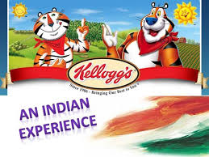
Kelloggs in India
Kellogg Company had set up its 30th manufacturing facility in India, with a total investment of $ 30 million. The Indian market held great significance for the Kellogg Company because its US sales were stagnating and only regular price increases had helped boost the revenues in the 1990s.
Launched in September 1994, Kellogg's initial offerings in India included cornflakes, wheat flakes and Basmati rice flakes.

Slide 12
Cultural Issues
Not as per Indian consumer tastes. Breakfasts habits of Indians is different.
A major reason for Kellogg's failure was the fact that the taste of its products did not suit Indian breakfast habits
Kellogg banked heavily on the quality of its crispy flakes. But pouring hot milk on the flakes made them soggy. Indians always boiled their milk unlike in the West and consumed it warm or lukewarm.

Slide 13
Daimler-Chrysler Cultural Clash

Slide 14
Merger-: May 1998
Challenge: Smooth Integration

Slide 15
CROSS-CULTURAL ISSUES
COMMUNICATION STYLES
In Germany the primary purpose of speech is to give and receive information. Americans are also factual, but use speech emphatically to give opinions and are more persuasive than Germans
Americans tend to evince optimism and put forward best scenarios. Germans are more comfortable with a cautious. “Yes, but what happens if …””? is a typically German attitude.
Americans, fond of humour, often reply in a rather flippant or casual manner. Germans fail to appreciate jokes, wisecracks or sarcasm during a business discussion.

Slide 16
TRAINING
-A 6-month training period.
-The time taken by the DaimlerChrysler University in considering the content of a cross cultural training programme resulted in most executive teams being sent from Stuttgart to the United States with no training at all.

Slide 17
PROCEDURAL AND STRUCTURAL DIFFERENCES
US corporations usually have strictly centralized reporting. Large German companies often feature decentralisation and compartmentalisation.
Americans go from office to office in their gregarious manner. German offices are strongholds of privacy, usually with doors shut.
Americans prize spontaneity, flexibility and adaptability in reaching their goals. Germans give pride of place to well-tested procedures and processes. If these structures have brought the company so far, why change things?

Slide 18
Root Causes for the Failure

Slide 19
ETHNOCENTRICISM-
Expatriates from the MNC’s home country manage the affairs of the subsidiaries. Local employees occupy low-level and supporting jobs.
Past performance at home and technical competence govern selection criteria for overseas assignments from home office.
HR policies and practices too flow from the home country .
Performance Appraisal and compensation use parent country standards.

Slide 20
Self-Reference Criterion: judging another person’s culture by the yardstick’s of your own culture.
All four companies used Self-reference criterion for judging what was appropriate and what was not appropriate in their ventures outside their home country.

Slide 21
Approaches Adaptive to other Cultures

Slide 22
POLYCETRICISM
Implies that the multinational corporation seeks to adapt to the local cultural needs of subsidiaries
If a management policy is oriented to suit local needs or if a product is customized to meet customer tastes it is Polycentricism.
In Polycentric staffing operations outside the home country are managed by individuals from the host country.
In HR policies local needs outweigh other considerations.
MNC’s conduct extensive training programmes in which host country managers visit home offices for extended periods.

Slide 24
GEOCENTRICISM
Subsidiaries may choose managers from the host country, from the home country or from a third country
The only criterion for selection is the merit of the applicant.
ADAVANTAGES
Company becomes truly cosmopolitan
Global managers are able to adjust to any business environment- particularly to cultural differences.
Compensation of expatriates is higher than for host country employees.

Slide 25
CULTURAL MODELS
HOFSTEDE’S MODEL

Slide 26
HOFSTEDE’S CULTURAL DIMENSIONS
Work done by Geert Hofstede
He identified cultural dimensions around which countries have been clustered with people in each group exhibiting identical behaviours.
Power distance
Uncertainty Avoidance
Individualism
Masculinity and Feminity
Long-term Orientation

Slide 27
India through Hofstede’s model

Slide 28
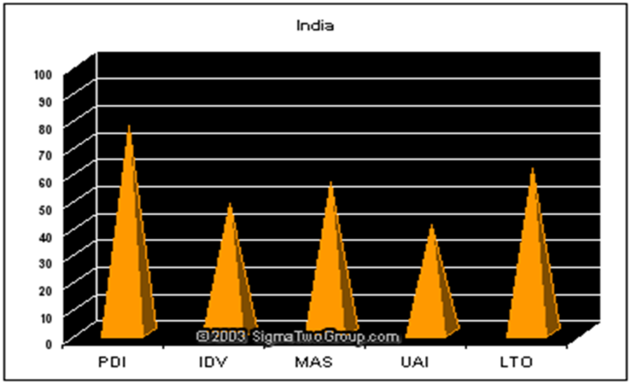
INDIA
Power Distance (PDI)-focuses on the degree of equality, or inequality, between people in the country's society.
India is a High power distance country. Age, gender, caste, credentials and wealth are some factors determining rank. An older, high caste, wealthy male commands the most respect in Indian society. Family is the glue which keeps the Indian society together.

Slide 29
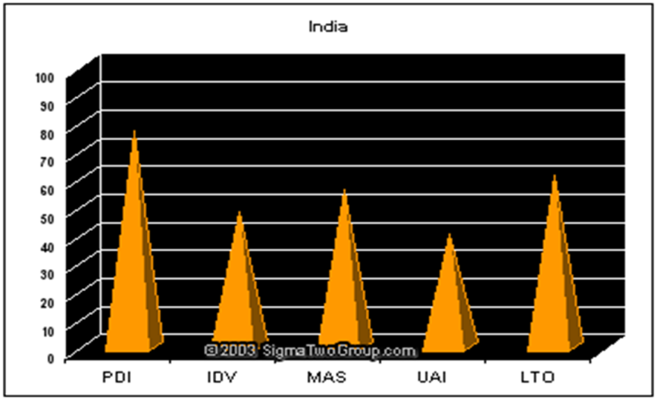
Individualism (IDV): Pertains to societies in which the ties between individuals are loose, and everyone is expected to look after themselves and their immediate families.
India scored 48 on IDV which is not very high and not very low.

Slide 30
Masculinity and Femininity
Masculinity pertains to societies in which social gender roles are clearly distinct, i.e. men are supposed to be assertive, tough and focused on material success, whereas women are supposed to be modest, tender and concerned with the quality of life.
India scored 56 in Masculinity Index.

Slide 31
INDIA
Uncertainty Avoidance
A High Uncertainty Avoidance ranking indicates the country has a low tolerance for uncertainty and ambiguity. This creates a rule-oriented society that institutes laws, rules, regulations, and controls in order to reduce the amount of uncertainty
India scored 40.

Slide 32
INDIA
Long-Term Orientation
it describes societies' time horizon. Long-term oriented societies attach more importance to the future. They foster values oriented towards rewards, including persistence, saving and capacity for adaptation. In short term oriented societies, values promoted are related to the past and the present, including steadiness, respect for tradition, preservation of one's face, reciprocation and fulfilling social obligations.
India has a moderate LTO of 60.

Slide 33
Competencies of an effective Global Manager
Knowledge of One’s own country
A Global perspective
Global Mindset
Knowledge of other countries
Understanding of International Business environment
Knowledge of customers
Knowledge of spoken international language
Knowledge of business etiquettes of the host country

Slide 34
Managing Expatriates
Willingness and enthusiasm of a person to work abroad
Multiculturist
Possess skills for positions overseas
Family background of the individual
Local laws of host countries

Slide 35
Repatriation Expatriation process also includes repatriation: the activity of bringing the expatriate back to the home country Re-entry presents new challenges: May experience re-entry shock Some exit the company

Slide 36
Individual reactions: job-related
Career anxiety
No post-assignment guarantee of employment
Loss of visibility and isolation
Changes in the home workplace
Work adjustment
The employment relationship and career expectation
Re-entry position
Devaluing of international experience
Coping with new role demands
Loss of status and pay

Slide 37
IMPACT OF CULTURAL DIVERSITY

Slide 38
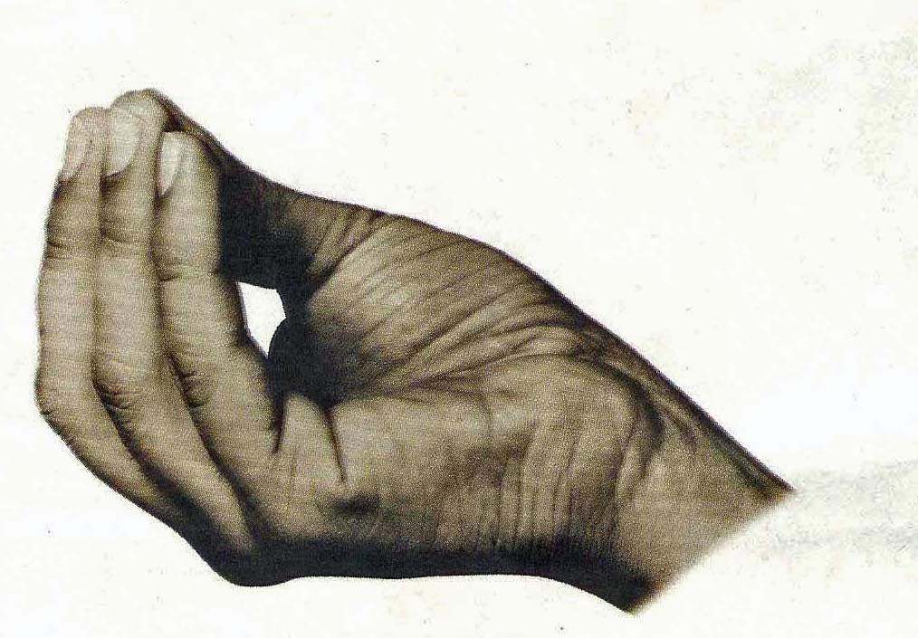
Non-Verbal Gestures

Slide 39
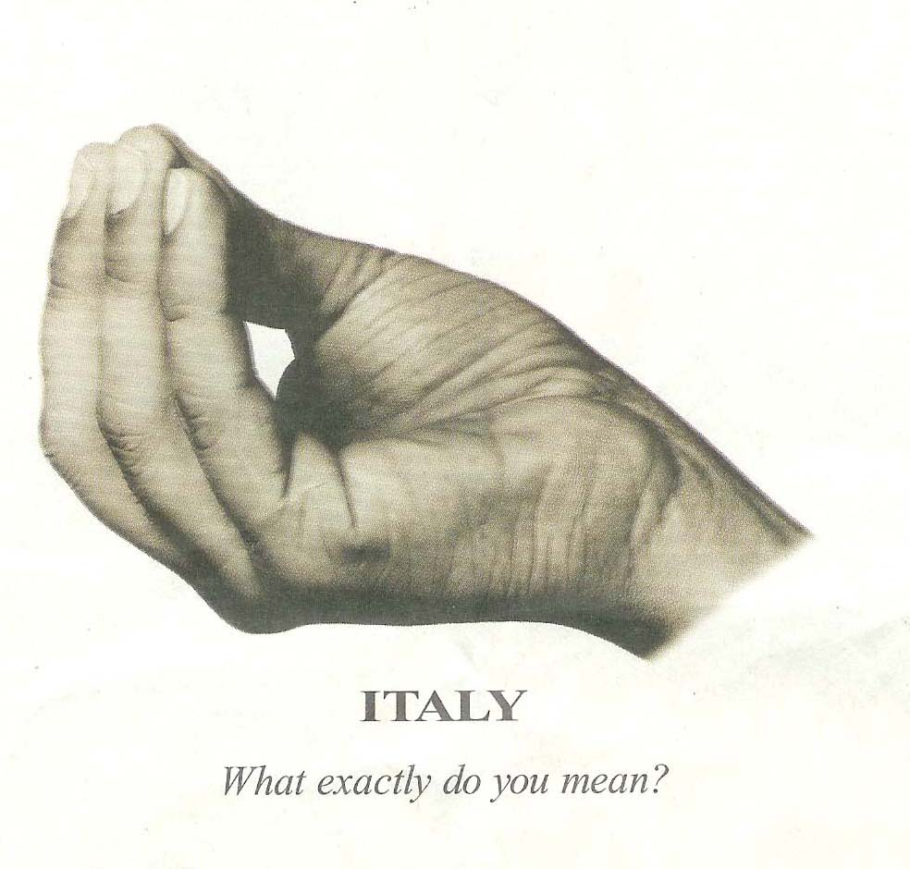
Non-Verbal Gestures

Slide 40
Non-Verbal Gestures

Slide 41
Non-Verbal Gestures

Slide 42
THANKYOU

