Slide 1
Module 2

Slide 2
Government of India : Structure

Slide 3
Constitutional Provisions for Labor
"Labour" related provisions under Constitution of India Part 3 ("Fundamental Rights") and Part 4 ("Directive Principles of State Policy")
FUNDAMENTAL RIGHTS Right to Freedom
Article 19: Protection of certain rights regarding freedom of speech, etc.- (1) All citizens shall have the right- (c) to form associations or unions; Right against Exploitation
Article 23: Prohibition of traffic in human beings and forced labour.- (1) Traffic in human beings and begar and other similar forms of forced labour are prohibited and any contravention of this provision shall be an offence punishable in accordance with law.
Article 24: Prohibition of employment of children in factories, etc.- No child below the age of fourteen years shall be employed to work in any factory or mine or engaged in any other hazardous employment.

Slide 4
DIRECTIVE PRINCIPLES OF STATE POLICY
Article 39: Certain principles of policy to be followed by the State.- The State shall, in particular, direct its policy towards securing- (a) that the citizens, men and women equally, have the right to an adequate means of livelihood; (d) that there is equal pay for equal work for both men and women; (e) that the health and strength of workers, men and women, and the tender age of children are not abused and that citizens are not forced by economic necessity to enter avocations unsuited to their age or strength; (f) that children are given opportunities and facilities to develop in a healthy manner and in conditions of freedom and dignity and that childhood and youth are protected against exploitation and against moral and material abandonment.
Article 41: Right to work, to education and to public assistance in certain cases.- The State shall, within the limits of its economic capacity and development, make effective provision for securing the right to work, to education and to public assistance in cases of unemployment, old age, sickness and disablement, and in other cases of undeserved want.
Article 42: Provision for just and humane conditions of work and maternity relief.- The State shall make provision for securing just and humane conditions of work and for maternity relief.
Article 43: Living wage, etc., for workers.- The State shall endeavour to secure, by suitable legislation or economic organisation or in any other way, to all workers, agricultural, industrial or otherwise, work, a living wage, conditions of work ensuring a decent standard of life and full enjoyment of leisure and social and cultural opportunities and, in particular, the State shall endeavour to promote cottage industries on an individual or co-operative basis in rural areas.
Article 43-A: Participation of workers in management of industries.- The State shall take steps, by suitable legislation or in any other way, to secure the participation of workers in the management of undertakings, establishments or other organisations engaged in any industry.

Slide 5
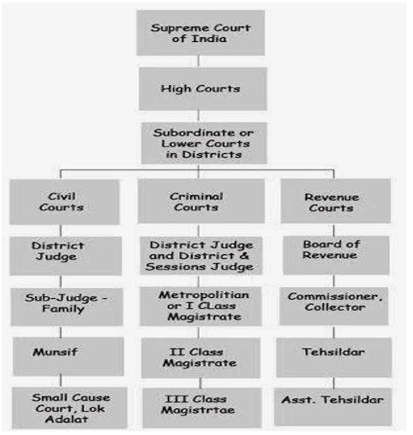
Structure of courts in India

Slide 7
Classification of Labour Legislations in India:-
Labour Laws may be classified under the following 6 heads:
I. Regulative Laws/Laws related to Regulation of Industrial Relations such as: -
Trade Unions Act, 1926 - Industrial Disputes Act, 1947.
II. Wage-related Laws/Laws governing wages such as: -Minimum Wages Act, 1948 -Payment of Bonus Act, 1965. -The Equal Remuneration Act, 1976
III. Protective laws/Laws related to Working Hours, Conditions of Service and Employment such as: - Factories Act, 1948.

Slide 8
IV. Welfare laws/Laws related to Deprived and Disadvantaged Sections of the Society such as: - Child Labour (Prohibition & Regulation) Act, 1986.
V. Laws related to Social Security such as: - Employees’ Compensation Act, 1923. - Employees’ State Insurance Act, 1948. - Employees’ Provident Fund & Miscellaneous Provisions Act, 1952. - Payment of Gratuity Act, 1972. - Maternity Benefit Act, 1961.
VI. Miscellaneous Labour laws such as; - Child Labour (prohibition and Regulation )Act,1986. - Apprentices Act ,1961.

